Slide 1
Intro to Databases
Lecture 1: Course Overview
Based on Stanford CS 145 & previous offering of CECS 535

Slide 2
The world is increasingly driven by data…
This class teaches the basics of how to use & manage data.

Slide 3
Key Questions We Will Answer
How can we collect and store large amounts of data?
  By building tools and data structures to efficiently index and serve data
How can we efficiently query data?
  By compiling high-level declarative queries into efficient low-level plans
How can we safely update data?
  By managing concurrent access to state as it is read and written
How do different database systems manage design trade-offs?
  e.g., at scale, in a distributed environment?

Slide 4
When you’ll use this material
Building almost any software application
  e.g., mobile, cloud, consumer, enterprise, analytics, machine learning
  Corollary: every application you use uses a database
  Bonus: every program consumes data (even if only the program text!)
Performing data analytics
  Business intelligence, data science, predictive modeling
  (Even if you’re using Pandas, you’re using relational algebra!)
Building data-intensive tools and applications
  Many core concepts power deep learning frameworks to self-driving cars

Slide 5
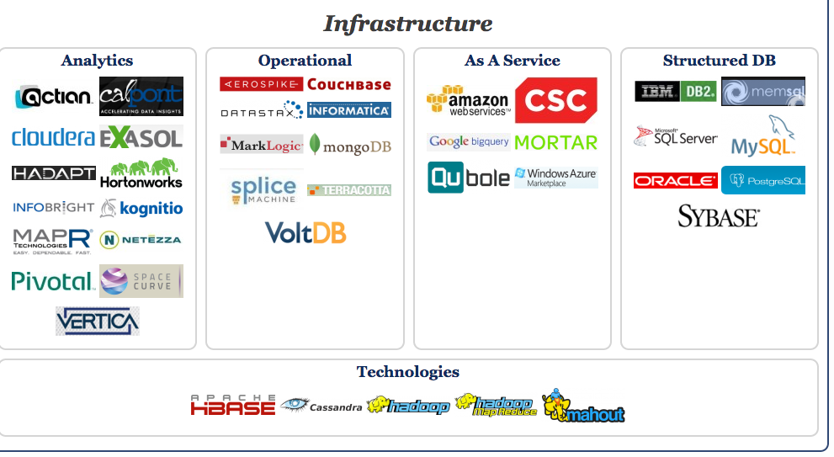
Big Data Landscape…
Infrastructure is Changing
Section 1 > Introduction
New tech. Same Principles.
http://www.bigdatalandscape.com/

Slide 6


Why should you study databases?
Section 1 > Introduction
Mercenary- make more $$$:
  Startups need DB talent right away = low employee #
  Massive industry…
Intellectual:
  Science: data poor to data rich
    No idea how to handle the data!
  Fundamental ideas to/from all of CS:
    Systems, theory, AI, logic, stats, analysis….
Many great computer systems ideas started in DB.

Slide 7
What this course is (and is not)
Section 1 > Introduction
Discuss fundamentals of data management
  How to design databases, query databases, build applications with them.
  How to debug them when they go wrong!
  Not how to be a DBA or how to tune Oracle 12g.
We’ll cover how database management systems work
And some (but not all of) the principles of how to build them

Slide 8
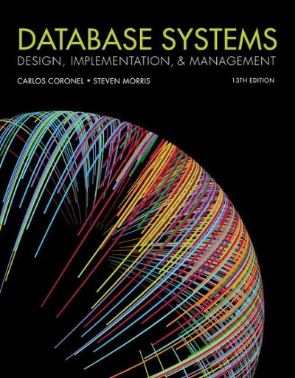
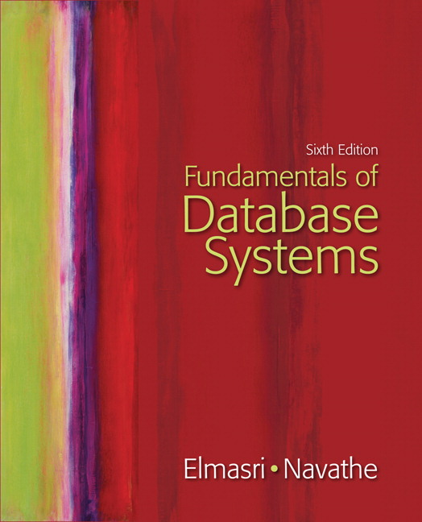
Lectures
Section 1 > Logistics
Lecture slides cover essential material
  Book provides more breath knowledge and explanation
Try to cover same thing in many ways: Lecture, lecture notes, homework, exams (no shock)
  Attendance makes your life easier…

Slide 9
Attendance
Section 1 > Logistics
I dislike mandatory attendance… but in the past we noticed…
  People who did not attend did worse ☹
  People who did not attend used more course resources ☹
  People who did not attend were less happy with the course ☹

Slide 10
Lectures: 1st half - from a user’s perspective
Section 1 > Lectures
Foundations: Relational data models & SQL
  Lectures 2-3
  How to manipulate data with SQL, a declarative language
    reduced expressive power but the system can do more for you
Database Design: Design theory and constraints
  Lectures 4-6
  Designing relational schema to keep your data from getting corrupted
Transactions: Syntax & supporting systems
  Lectures 7-8
  A programmer’s abstraction for data consistency

Slide 11
Lectures: 2nd half - understanding how it works
Section 1 > Lectures
4. Introduction to database systems
  Lectures 9-16
  Indexing
  External Memory Algorithms (IO model) for sorting, joins, etc.
  Basics of query optimization (Cost Estimates)
  Relational algebra
5. Specialized and New Data Processing Systems
  Lectures 17-19
  Key-Value Stores
  Hadoop and its 10 year anniversary
  SparkSQL. The re-rise of SQL
  Next-gen analytics systems & current intersections with ML & AI

Slide 12
2. Overview of the relational data model
Section 2

Slide 13
What you will learn about in this section
Section 2
Definition of DBMS
Data models & the relational data model
Schemas & data independence
ACTIVITY: Jupyter + SQL

Slide 14
What is a DBMS?
Section 2 > DBMS
What is DB?
  A large, integrated collection of data
  Models a real-world enterprise
    Entities (e.g., Students, Courses)
    Relationships (e.g., Alice is enrolled in 145)
A Database Management System (DBMS) is a piece of software designed to store and manage databases

Slide 15
A Motivating, Running Example
Section 2 > Data models
Consider building a course management system (CMS):
  Students
  Courses
  Professors
  Who takes what
  Who teaches what
Entities
Relationships

Slide 16
Data models
Section 2 > Data models
A data model is a collection of concepts for describing data
  The relational model of data is the most widely used model today
    Main Concept: the relation- essentially, a table
A schema is a description of a particular collection of data, using the given data model
  E.g. every relation in a relational data model has a schema describing types, etc.

Slide 17
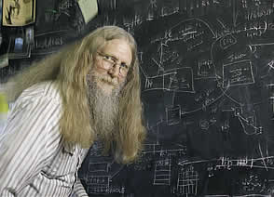
“Relational databases form the bedrock of western civilization”
Section 2 > Data models
- Bruce Lindsay, IBM Research

Slide 18
Modeling the CMS
Section 2 > Data models
Logical Schema
  Students(sid: string, name: string, gpa: float)
  Courses(cid: string, cname: string, credits: int)
  Enrolled(sid: string, cid: string, grade: string)
sid | Name | Gpa
101 | Bob | 3.2
123 | Mary | 3.8
Relations
cid | cname | credits
564 | 564-2 | 4
308 | 417 | 2
Students
sid | cid | Grade
123 | 564 | A
Courses
Enrolled

Slide 19
Modeling the CMS
Section 2 > Data models
Logical Schema
  Students(sid: string, name: string, gpa: float)
  Courses(cid: string, cname: string, credits: int)
  Enrolled(sid: string, cid: string, grade: string)
sid | Name | Gpa
101 | Bob | 3.2
123 | Mary | 3.8
Corresponding keys
cid | cname | credits
564 | 564-2 | 4
308 | 417 | 2
Students
sid | cid | Grade
123 | 564 | A
Courses
Enrolled

Slide 20
Other Schemata…
Section 2 > Schemata
Physical Schema: describes data layout
  Relations as unordered files
  Some data in sorted order (index)
Logical Schema: Previous slide
External Schema: (Views)
  Course_info(cid: string, enrollment: integer)
  Derived from other tables
Administrators
Applications

Slide 21
Data independence
Section 2 > Schemata
Concept: Applications do not need to worry about how the data is structured and stored
Logical data independence: protection from changes in the logical structure of the data
I.e. should not need to ask: can we add a new entity or attribute without rewriting the application?
Physical data independence: protection from physical layout changes
I.e. should not need to ask: which disks are the data stored on? Is the data indexed?
One of the most important reasons to use a DBMS

Slide 22
Activity-1-2.ipynb
Section 2 > ACTIVITY

Slide 23
3. Overview of DBMS topics
Section 3
Key concepts & challenges

Slide 24
What you will learn about in this section
Section 3
Transactions
Concurrency & locking
Atomicity & logging
Summary

Slide 25
Challenges with Many Users
Section 3 > DBMS Challenges
Suppose that our CMS application serves 1000’s of users or more- what are some challenges?
  Security: Different users, different roles
  Performance: Need to provide concurrent access
  Consistency: Concurrency can lead to update problems
  We won’t look at too much in this course, but is extremely important
  Disk/SSD access is slow, DBMS hide the latency by doing more CPU work concurrently
DBMS allows user to write programs
as if they were the only user

Slide 26
Transactions
Section 3 > DBMS Challenges
A key concept is the transaction (TXN): an atomic sequence of db actions (reads/writes)
Atomicity: An action either completes entirely or not at all
Acct | Balance
A | 20,000
B | 15,000
Transfer $3k from A to B:
Debit $3k from A
Credit $3k to B
Acct | Balance
A | 17,000
B | 18,000
Written naively, in which states is atomicity preserved?
Crash before 1,
After 1 but before 2,
After 2.
DB Always preserves atomicity!

Slide 27
Transactions
Section 3 > DBMS Challenges
A key concept is the transaction (TXN): an atomic sequence of db actions (reads/writes)
  If a user cancels a TXN, it should be as if nothing happened!
Transactions leave the DB in a consistent state
  Users may write integrity constraints, e.g., ‘each course is assigned to exactly one room’
Atomicity: An action either completes entirely or not at all
Consistency: An action results in a state which conforms to all integrity constraints
However, note that the DBMS does not understand the real meaning of the constraints– consistency burden is still on the user!

Slide 28
Challenge: Scheduling Concurrent Transactions
Section 3 > DBMS Challenges
The DBMS ensures that the execution of {T₁,…,T_{n}} is equivalent to some serial execution
One way to accomplish this: Locking
  Before reading or writing, transaction requires a lock from DBMS, holds until the end
Key Idea: If T_{i} wants to write to an item x and T_{j} wants to read x, then T_{i}, T_{j} conflict. Solution via locking:
  only one winner gets the lock
  loser is blocked (waits) until winner finishes
A set of TXNs is isolated if their effect is as if all were executed serially
What if T_{i} and T_{j} need X and Y, and T_{i} asks for X before T_{j,} and T_{j} asks for Y before T_{i}?
-> Deadlock! One is aborted…
All concurrency issues handled by the DBMS…

Slide 29
Ensuring Atomicity & Durability
Section 3 > DBMS Challenges
DBMS ensures atomicity even if a TXN crashes!
One way to accomplish this: Write-ahead logging (WAL)
Key Idea: Keep a log of all the writes done.
  After a crash, the partially executed TXNs are undone using the log
Write-ahead Logging (WAL): Before any action is finalized, a corresponding log entry is forced to disk
We assume that the log is on “stable” storage
All atomicity issues also handled by the DBMS…

Slide 30
A Well-Designed DBMS makes many people happy!
Section 3 > Summary
End users and DBMS vendors
  Reduces cost and makes money
DB application programmers
  Can handle more users, faster, for cheaper, and with better reliability / security guarantees!
Database administrators (DBA)
  Easier time of designing logical/physical schema, handling security/authorization, tuning, crash recovery, and more…
Must still understand
DB internals

Slide 31
Summary of DBMS
Section 3 > Summary
DBMS are used to maintain, query, and manage large datasets.
  Provide concurrency, recovery from crashes, quick application development, integrity, and security
Key abstractions give data independence
DBMS R&D is one of the broadest, most exciting fields in CS. Fact!

